Slide 1



CERVICARE
accessible gynecologic cancer screenings
in the comfort of your home
Notes:
Notes: Lihn will make edits to her parts of the script and BG will make the more “cumulative” edits to the script her her sparts…
Slide 7 needs to be adapted – BG (complete 3/3)
Slide 12 needs to be made (priority) – BG (complete 3/3)
Slide 14, 16, 17 need to be made – BG (complete 3/3)
Slide 15 needs to be made – Nellie – done on April 1

Slide 2





14 MILLION
the number of women eligible for
cervical cancer screening in the US every year
personal scheduling difficulties & inconvenient clinic visits
uncomfortable, invasive test
high testing costs, travel expenses, & potential lost wages

Slide 3
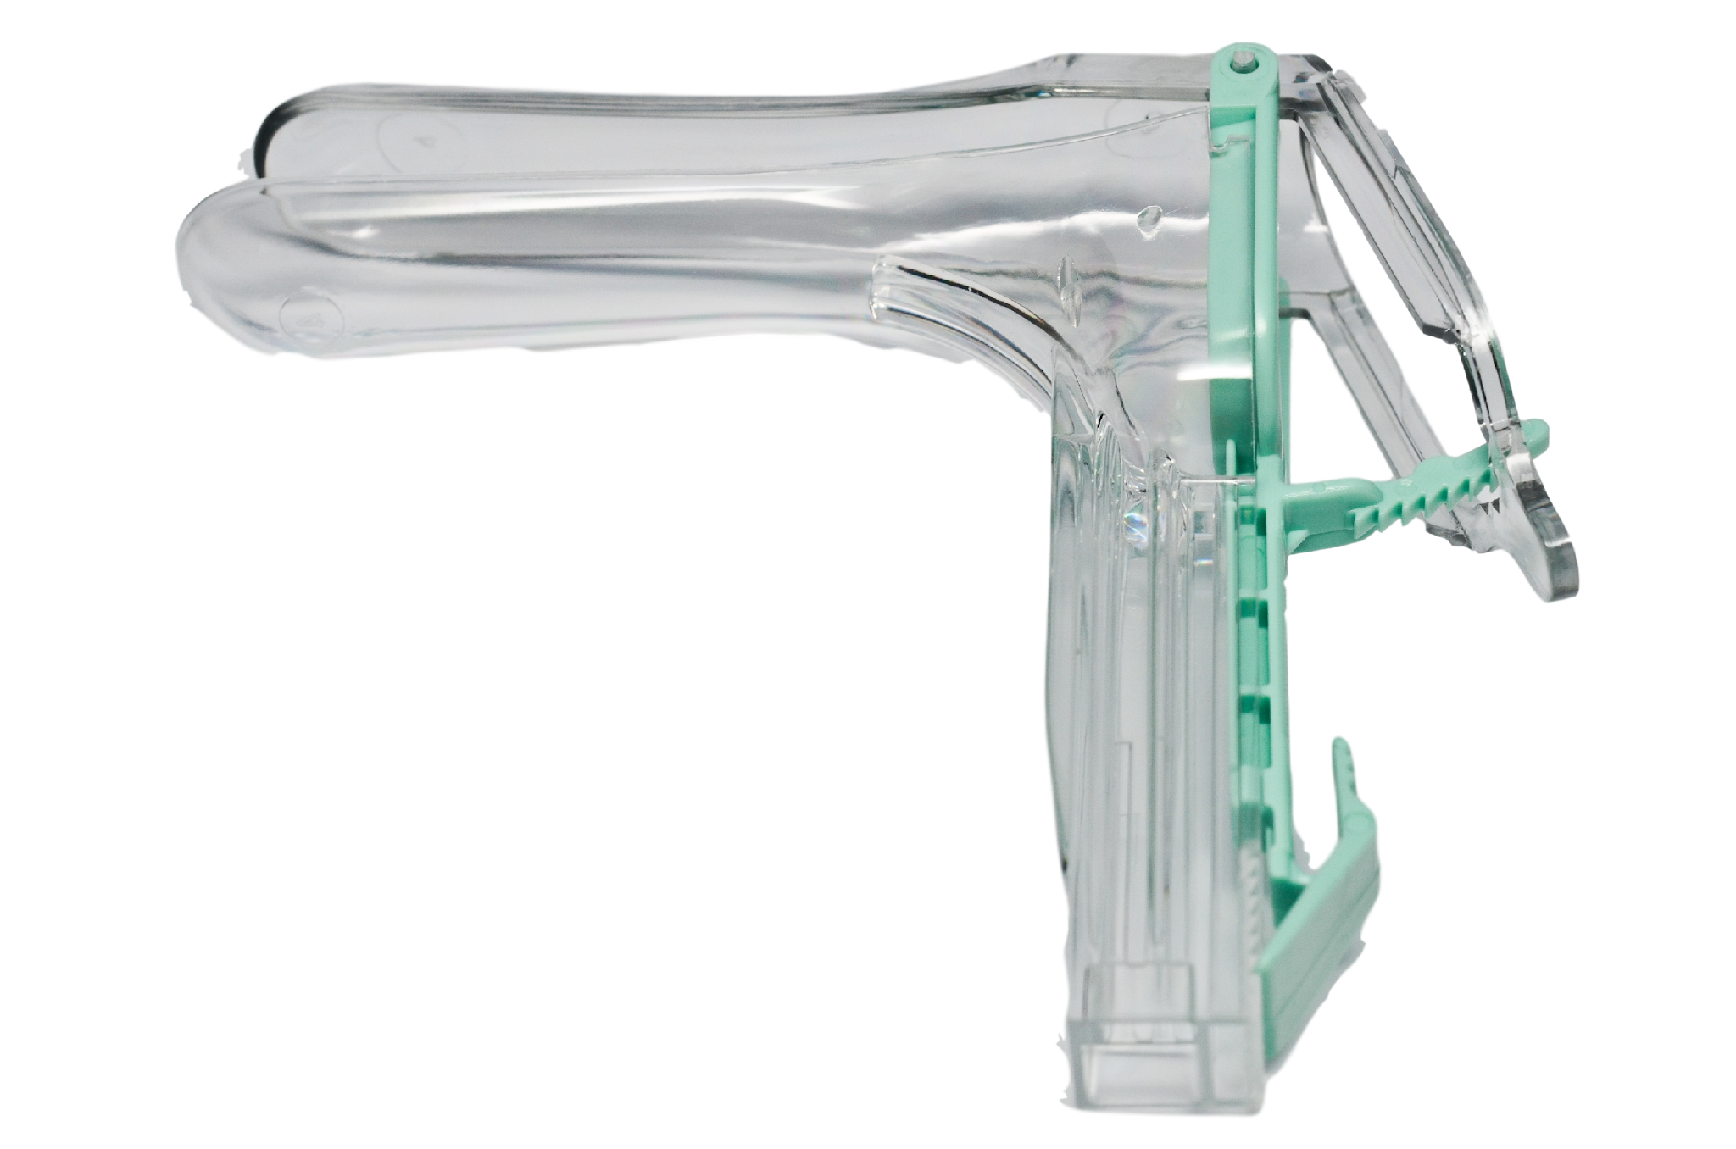
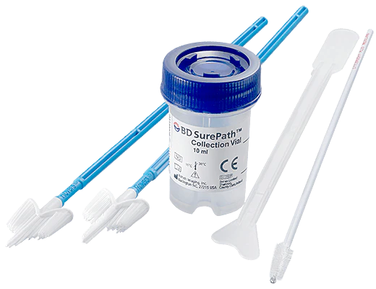
CURRENT STANDARD OF CARE
Pap smear
47% sensitivity
65% specificity
$50-150 average price range for a Pap smear in the United States
Notes:
Source: Diagnostic Accuracy of Cervical Pap Smear and Colposcopy in Detecting Premalignant and Malignant Lesions of Cervix

Slide 4


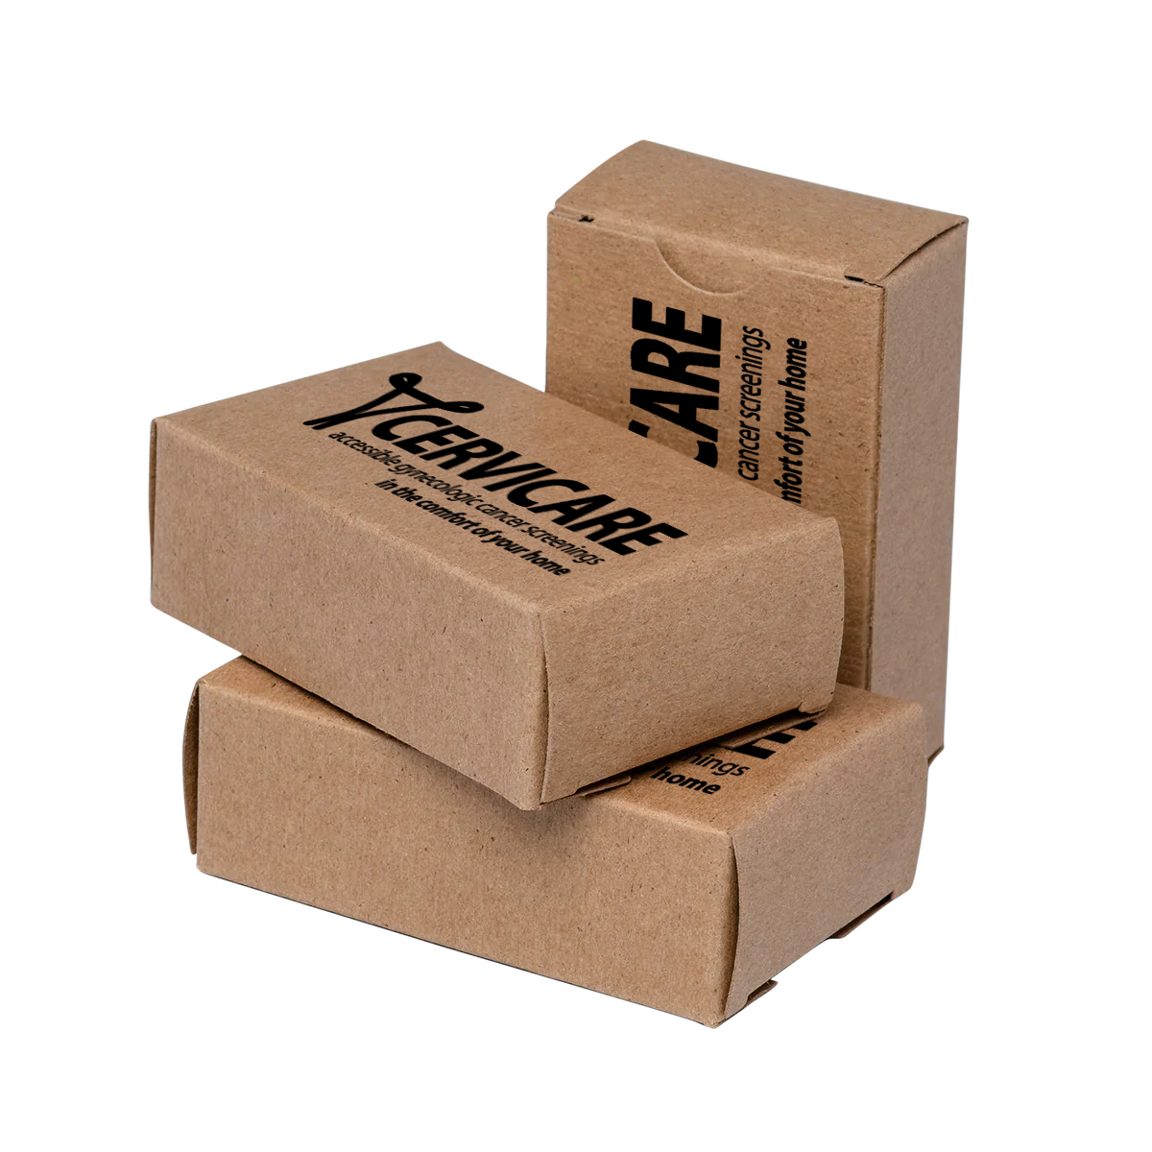

21st CENTURY SCREENING
Comfort
self-collected sample at home or in the office
Convenience
no longer necessary to coordinate time off work, accommodate traveling, or schedule doctor’s appointments
Privacy bringing the sensitive procedure to your own hands
Notes:
Needs to be edited to include both business models

Slide 5
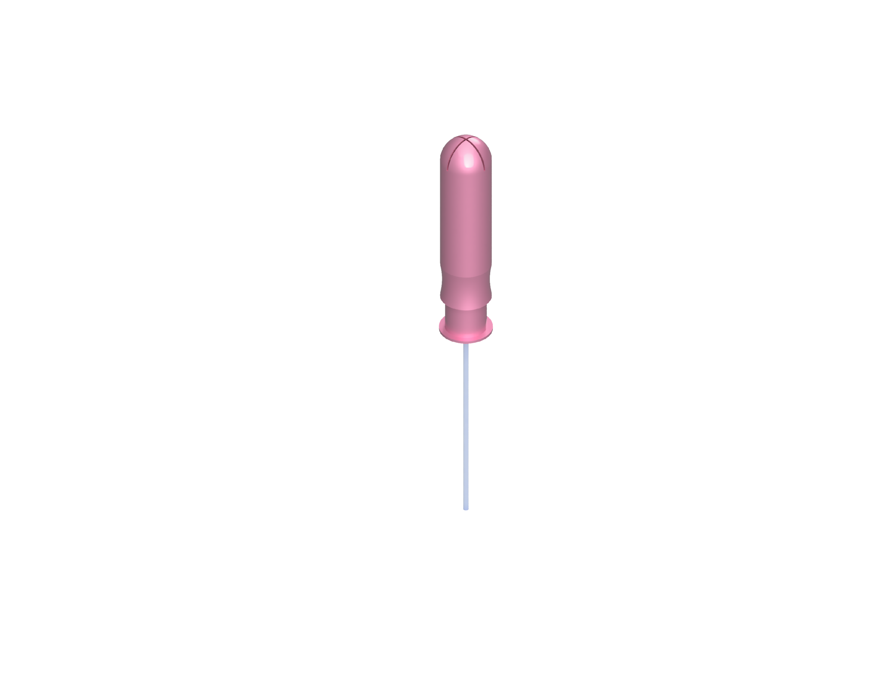
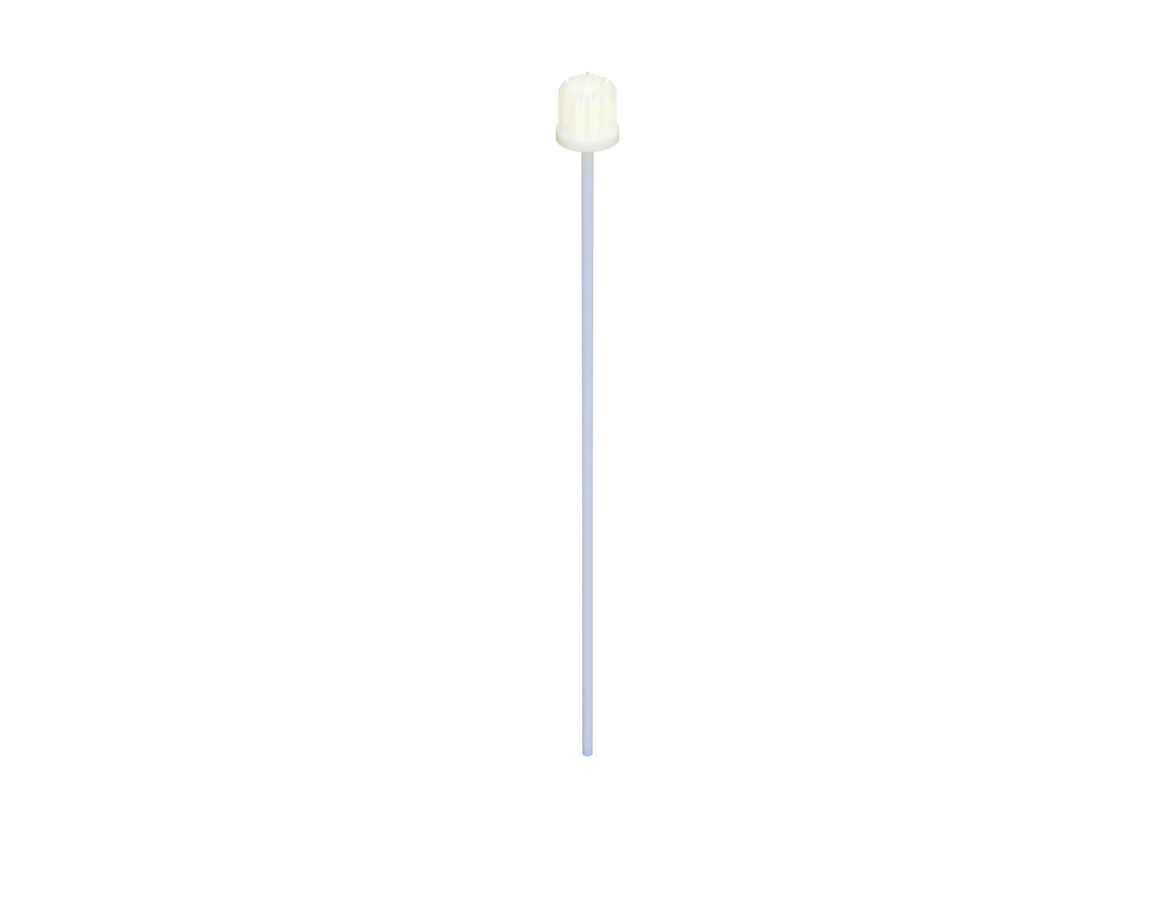

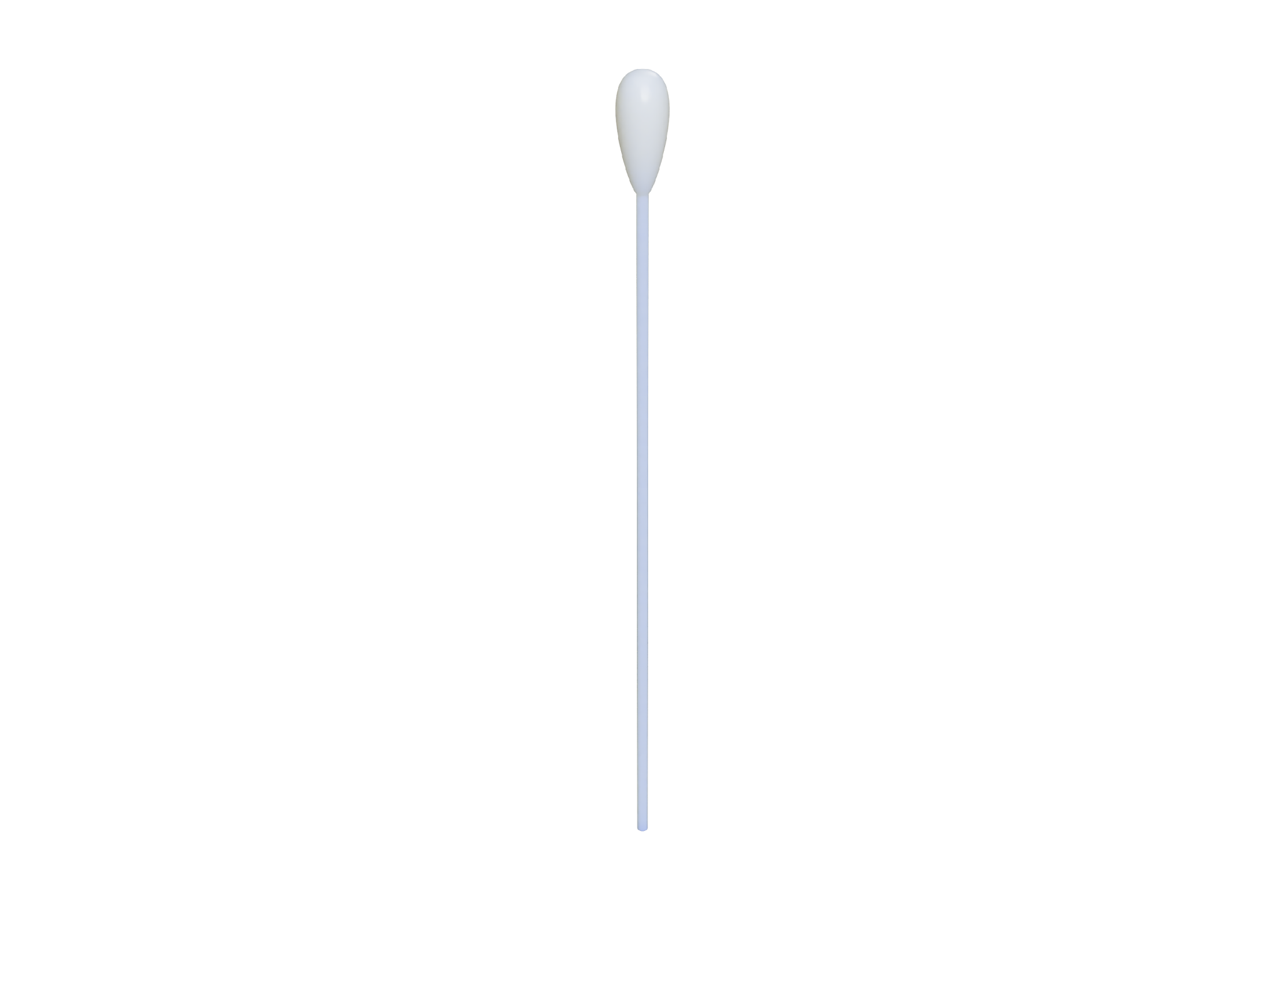

Step 1: Collect sample
Step 2: Send the sample to Cervicare testing facility through US Mail with a prepaid label
Step 3: Sample analysis
Step 4: Results & follow-up, if needed
CERVICARE
accessible gynecologic cancer screenings
in the comfort of your home

Slide 6

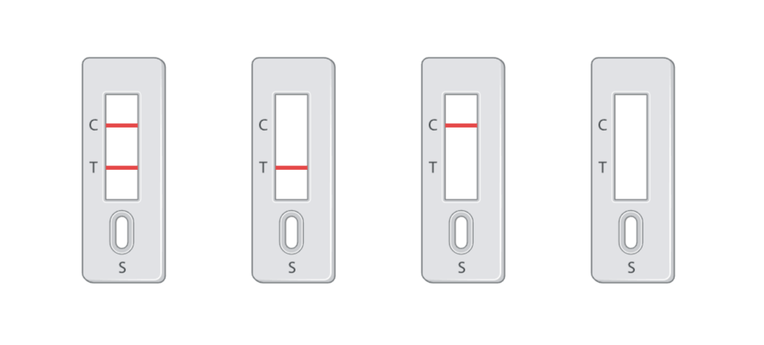


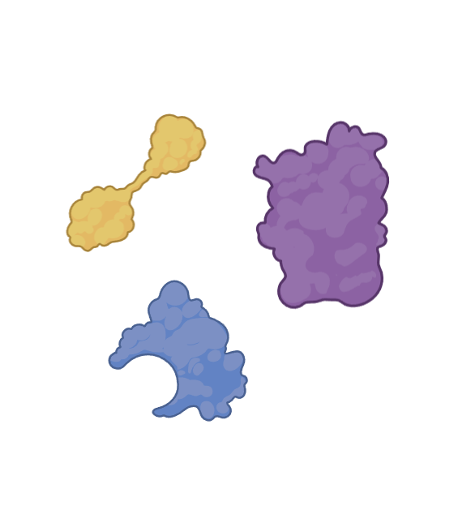


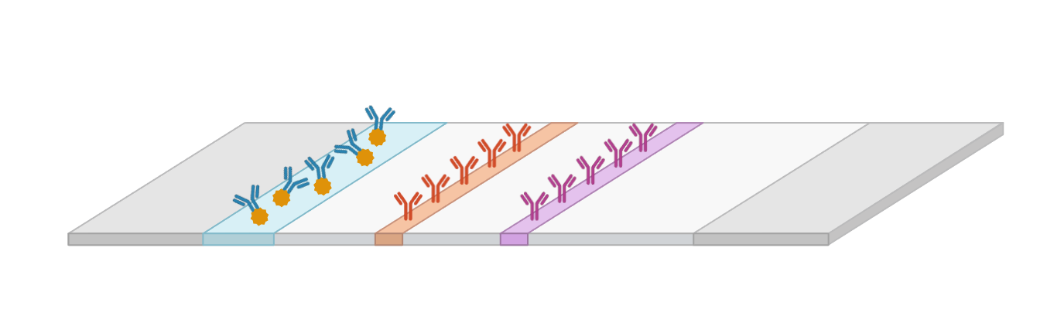
LATERAL FLOW ASSAY FOR CERVICAL CANCER DETECTION
Positive
Negative
Invalid
Notes:
BG to add the automation model (will use BioRender automation pictures to make it clear)

Slide 7

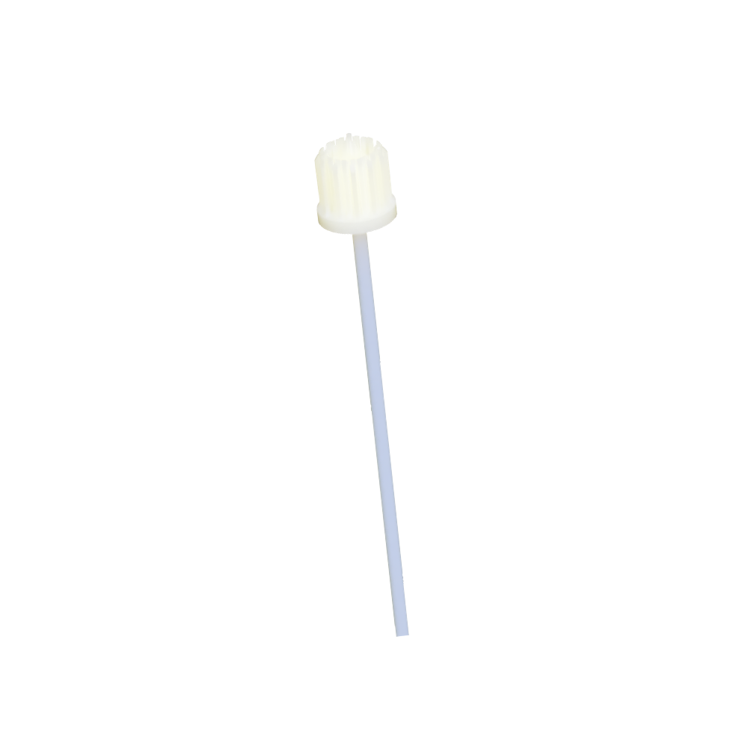


PROGRESS SO FAR
Ideation
alternatives to the Pap test narrowed down to our collection system design
Prototyping & Selection
several collection brushes were designed and selected for initial manufacturing & testing
Proof-of-Concept with Biomarkers
biomarkers used for the sensing platform were confirmed via extensive experimentation

Slide 8

GO-TO-MARKET & EXPANSION
Aim
insurance coverage as the new standard-of-care in the United States
Philanthropic Efforts
profits to ultimately fund philanthropic efforts for increased HPV & cervical cancer screenings first in the United States, then worldwide

Slide 9



WHAT’S NEXT?
Manufacturing
low-scale, high-fidelity prototypes manufactured in-house
Collection System Proof-of-Concept
female reproductive system model produced using a silicon-based phantom tissue
experimentation with patient sample collection at clinical collaborator site will begin in 2027

Slide 10
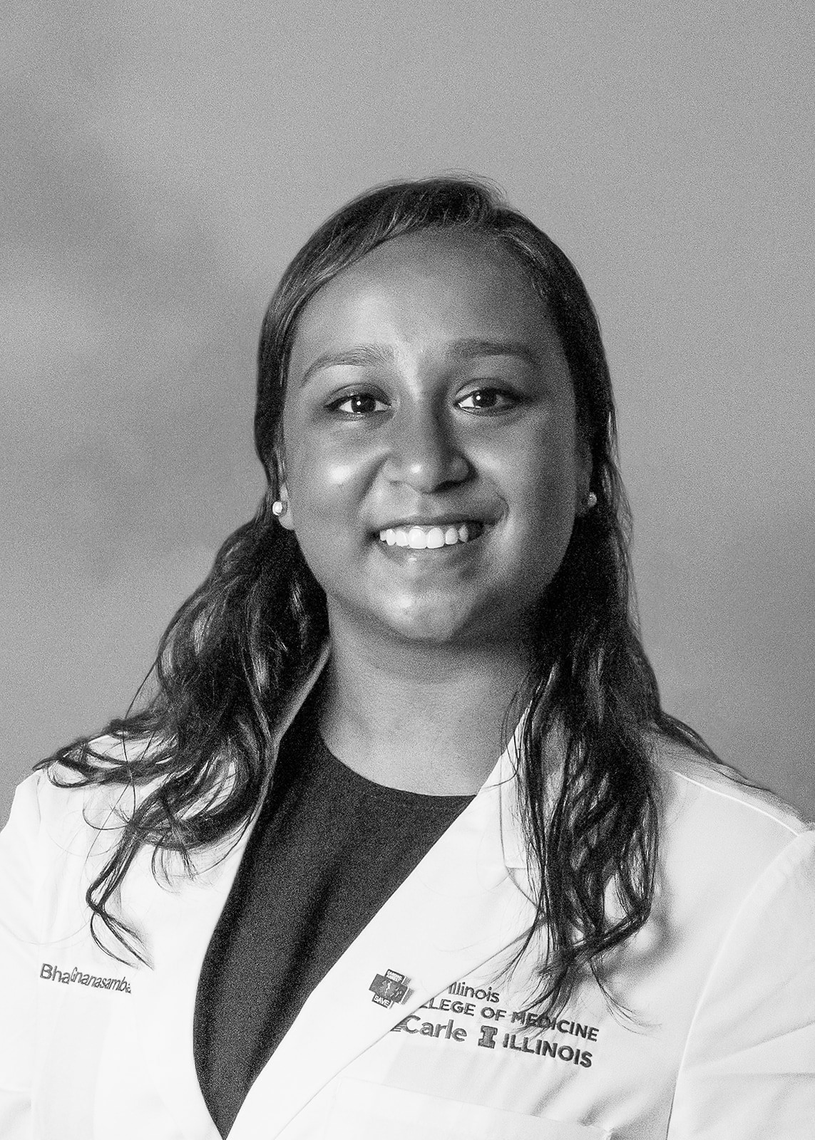
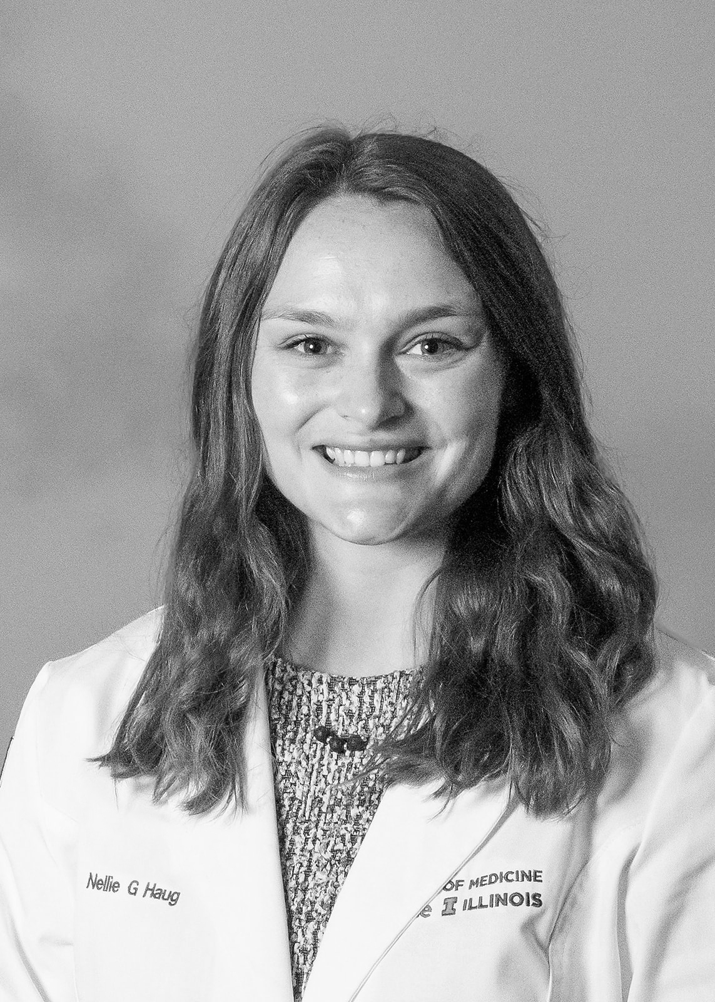

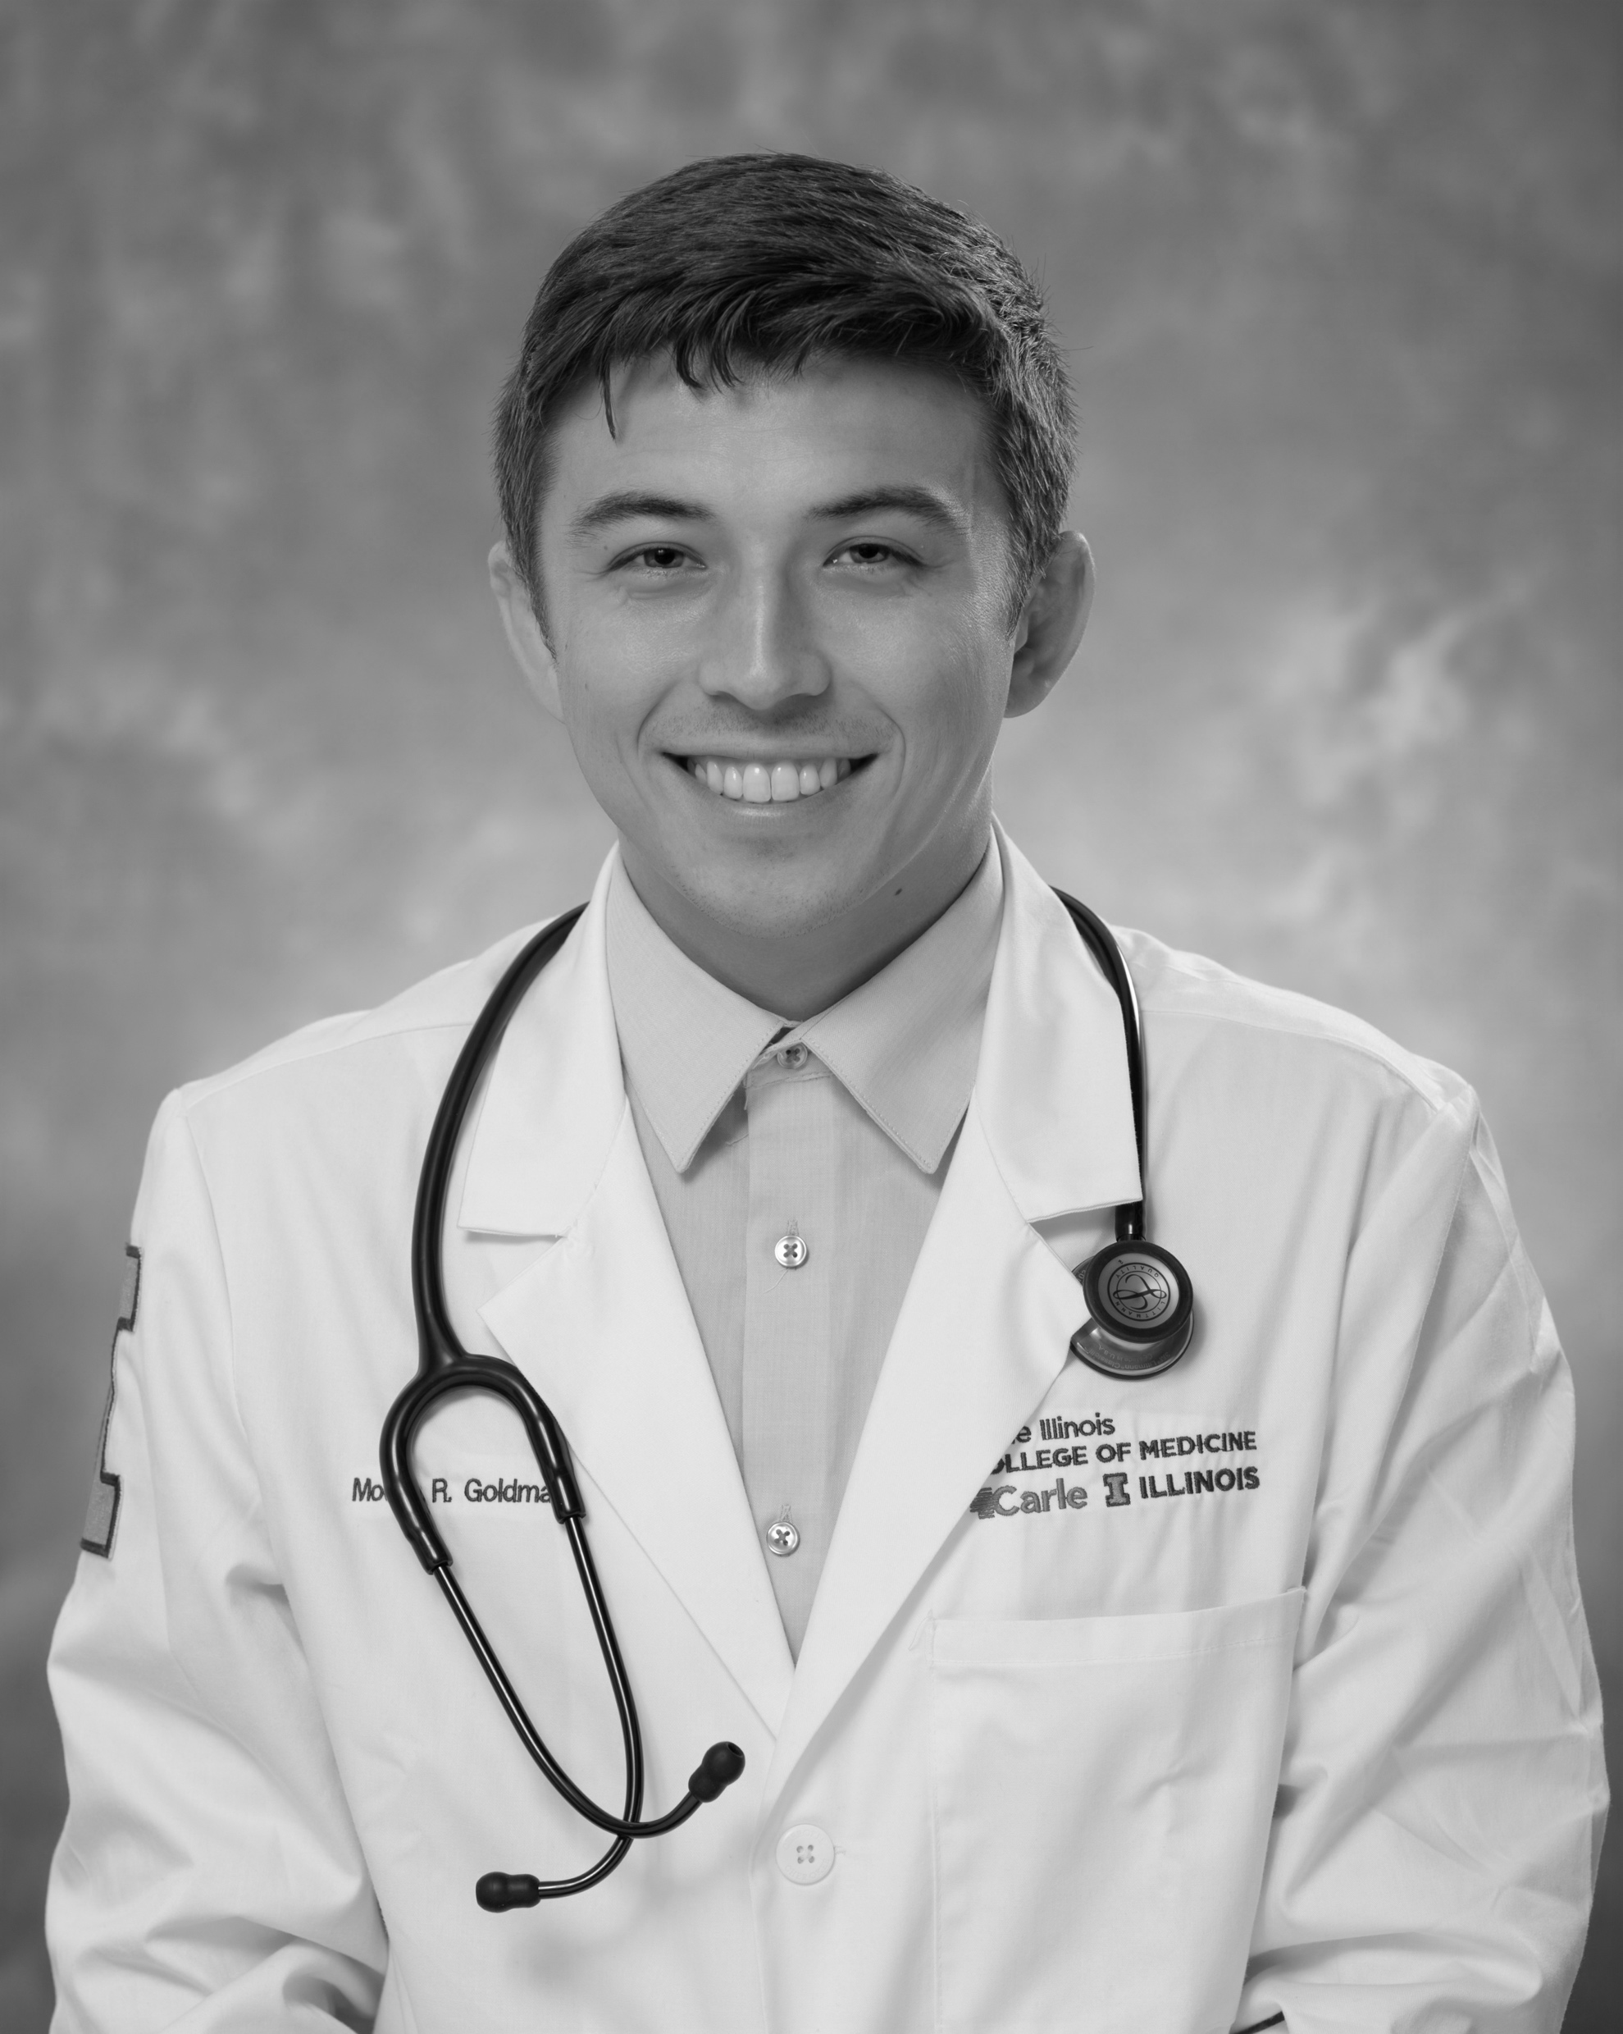
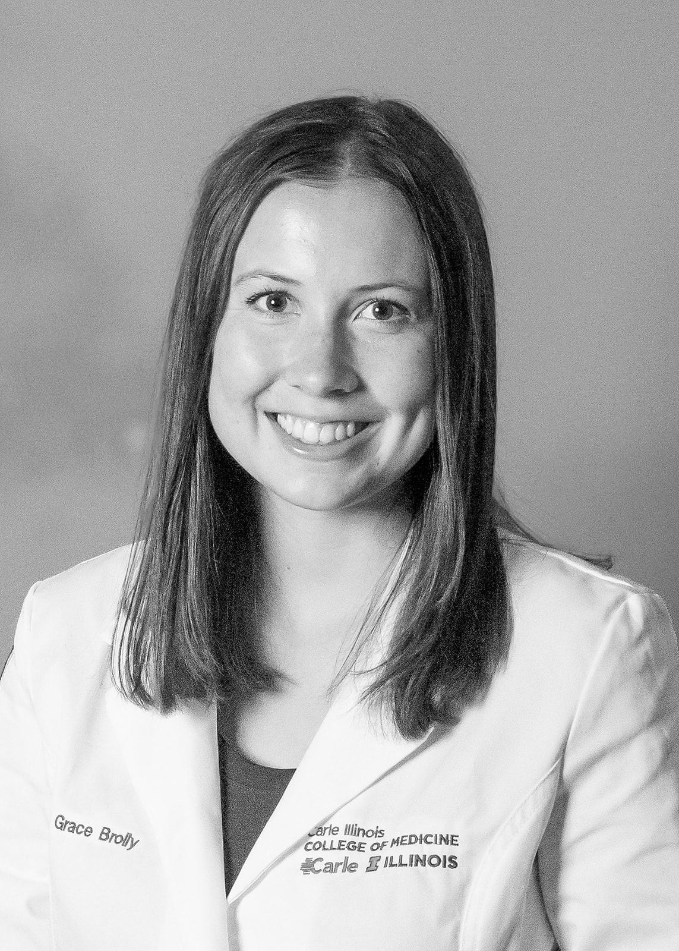

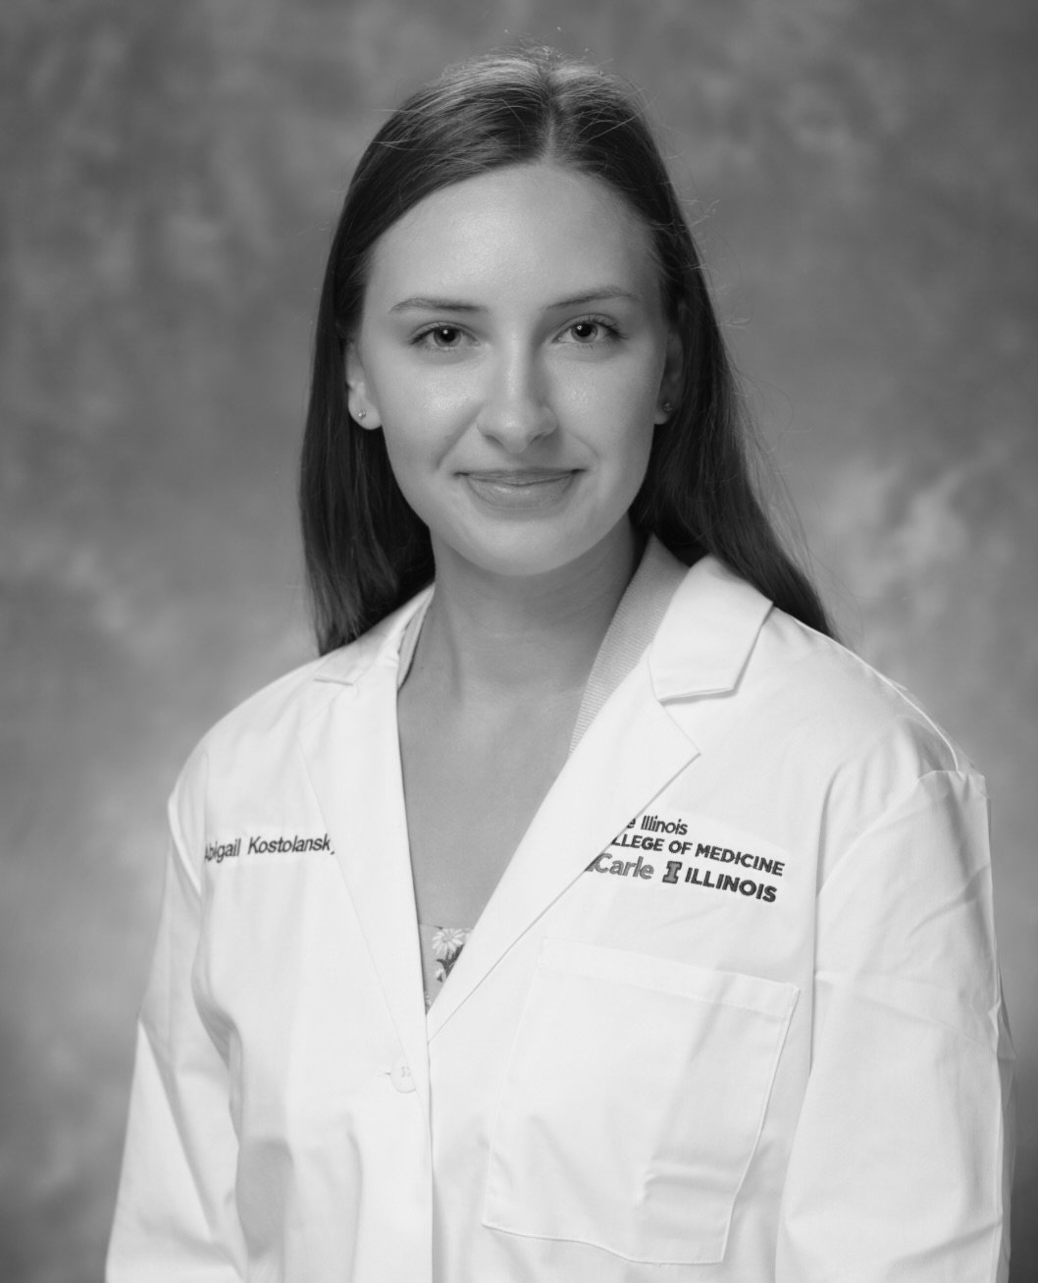
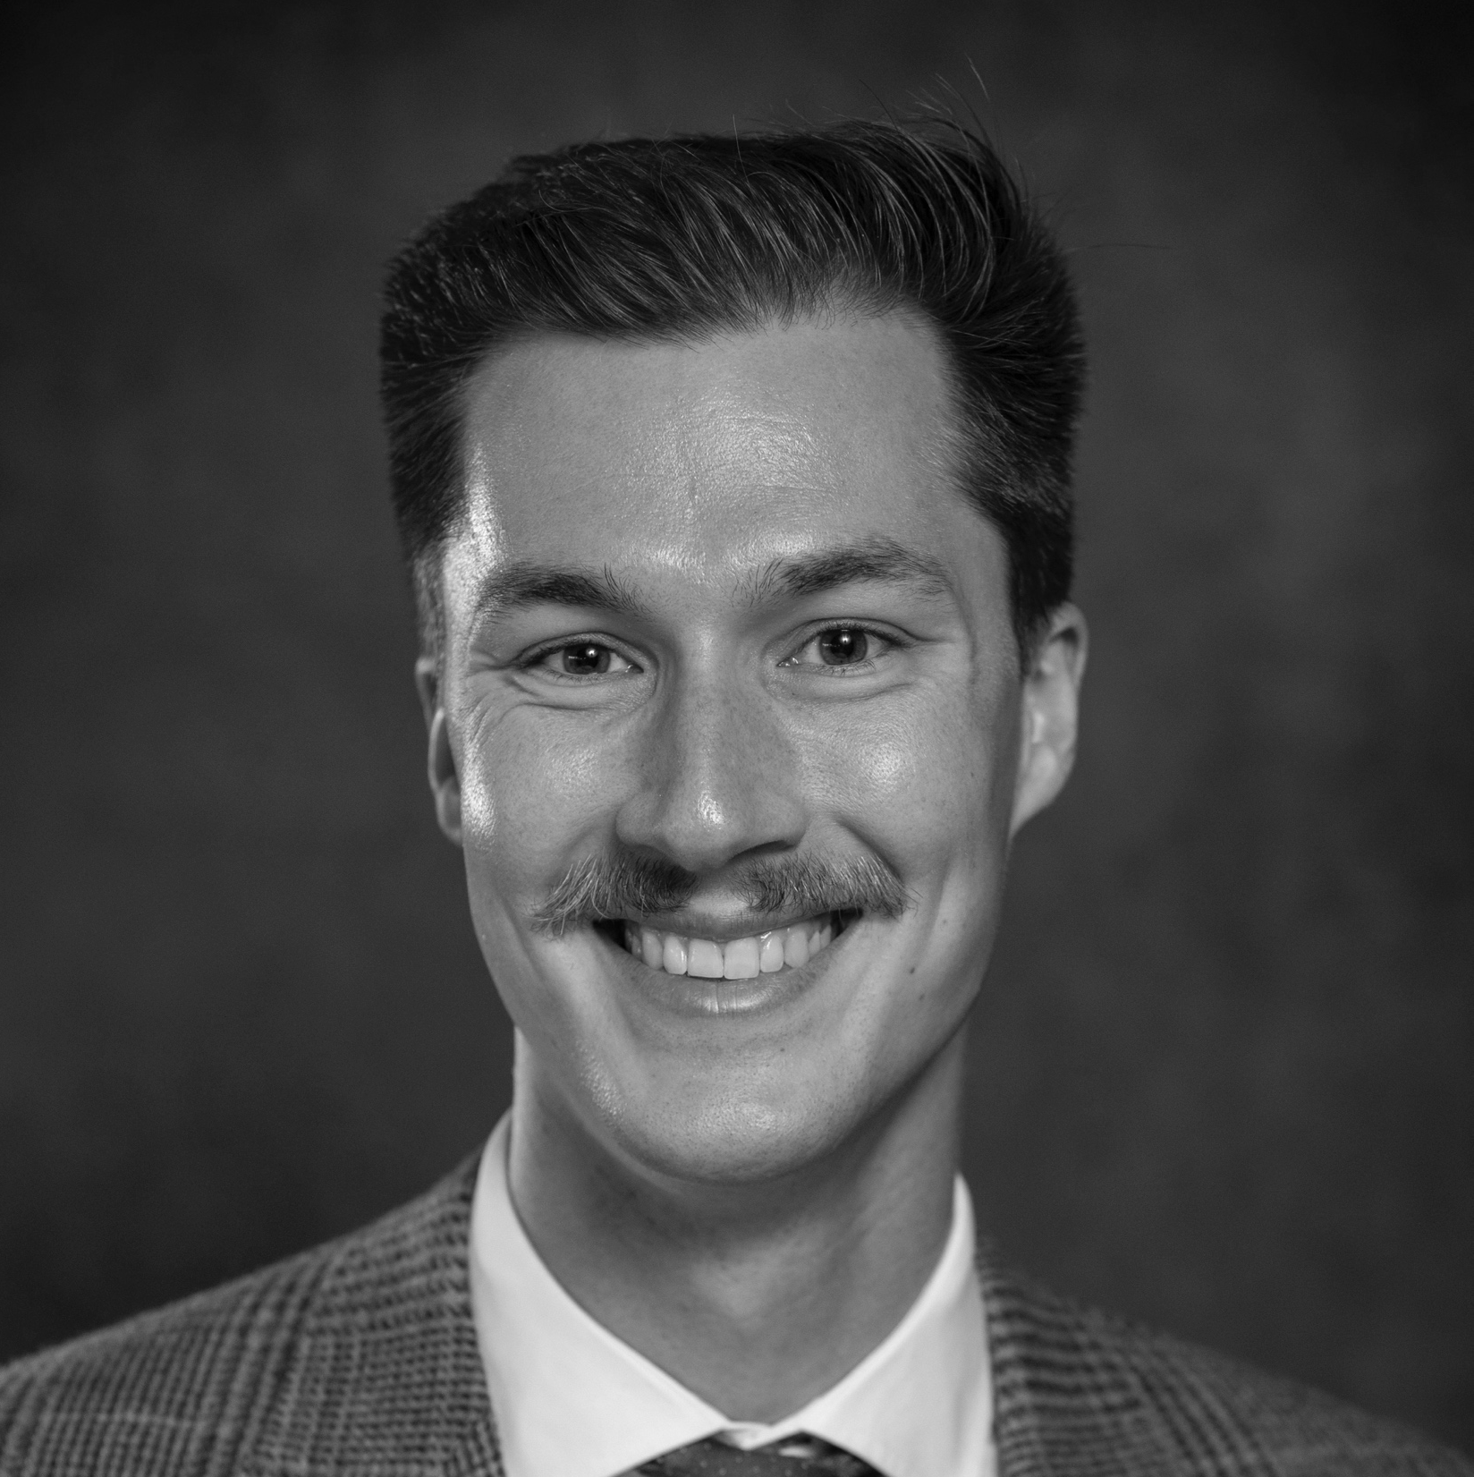

OUR TEAM
Bhargavee Gnana
Nellie Haug
Nama Naseem
PhD Student | BioE
M3 | CIMED
Co-founder
M3 | CIMED
BS MechSE
Co-founder
M2 | CIMED
BS BME
Modan Goldman
Grace Brolly
Linh Pham
M3 | CIMED
BS BME
PhD Student | BioE
BS Medical Science and Technology
M3 | CIMED
BS Ecology
Abby Kostolansky
Matthew Raab
Joseph Irudayaraj
MPH, MUP | UIUC
BS Ag Econ
Professor of BioE
PhD BioE
MS Biosystems Eng
MS Information & CS
M2 | CIMED
BA Chemistry

Slide 11




FUNDING
NEEDS
Clinical Testing
$50k
Product Development $120K
Trademark and IP
$50k
Business Development
$30k
Notes:
This needs some alignment work

Slide 12
CERVICARE
accessible gynecologic cancer screenings
in the comfort of your home

Slide 13



CURRENT COMPETITORS
Cost- effective | ✓ | ✓
Comfortable | ✓ | ✓ | ✓ | ✓
Home-Use | ✓ | ✓
Clinic Use | ✓ |  | ✓ | ✓
HPV Testing | ✓ | ✓ | ✓ | ✓
Cervical Cancer Biomarker Testing | ✓
Notes:
Teal Health - Actually doing what we are doing with a self-testing wand with the cologuard model
Roche - CIN dual staining AND COBAS (HPV self-testing)
Holologic - Cervical Cancer Screening Company (makes multiple HPV tests)

Slide 14
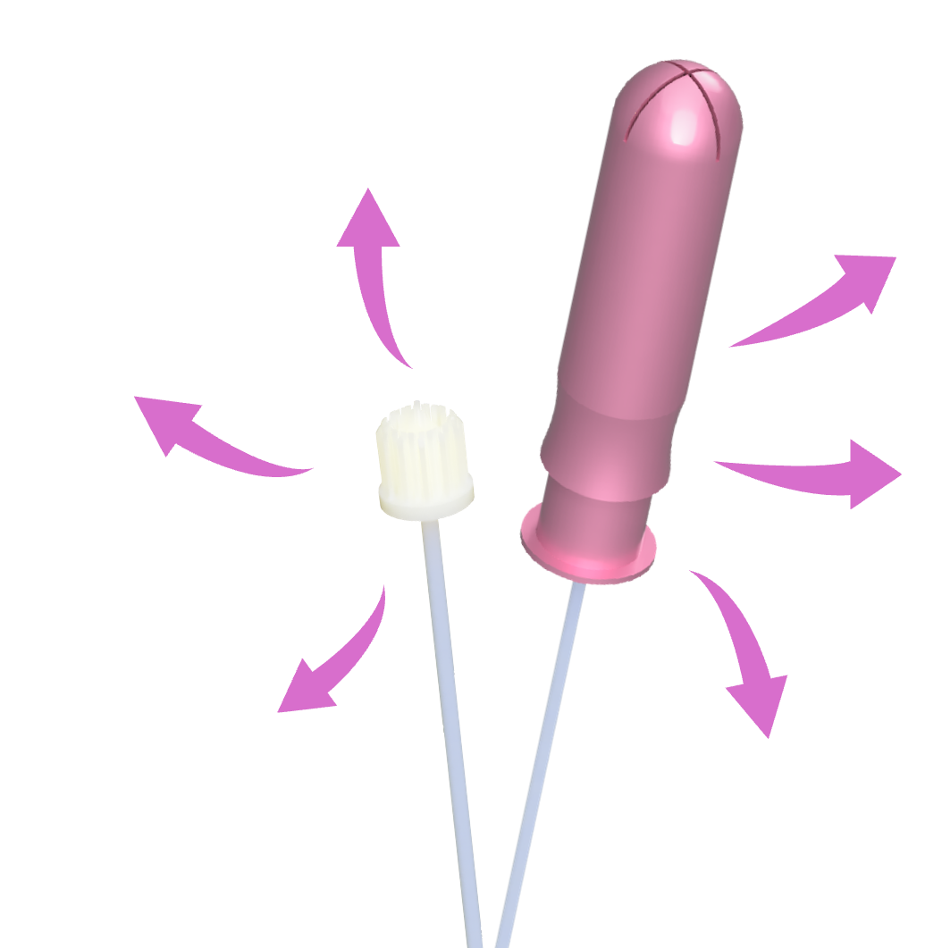
EXTENDED APPLICATIONS
HIV
Cervical Cancer
Chlamydia
Endometrial & Vaginal Cancers
Vaginal Health Monitoring
Gonorrhea

Slide 15
FDA CLEARANCE
Class II Medical Device
Part 884 – OBSTETRICAL & GYNECOLOGICAL DEVICES
Subpart B – Diagnostic Devices
De Novo Classification Request (most likely)
if no valid predicate exists, we would pursue a De Novo request, classifying Cervicare as a new Class II device with special controls
510(k) Premarket Notification (unlikely)
this applies if the device is similar in intended use, design, and performance characteristics to an existing cleared device
21 CFR 884.4530 – Obstetric-gynecologic specialized manual instrument (potential predicate for the brush collection component)
21 CFR 884.5900 – Vaginal insert (potential predicate for the tampon-like applicator design)

Slide 16
CERVICARE USE-CASE TIMELINES
AT HOME USE
Patient uses Cervicare swab to collect sample
Mails sample to Cervicare testing facility
Results sent to doctor and patient
2. POINT OF CARE TESTING
Patient uses Cervicare swab to collect sample
Healthcare Provider runs lateral flow assay
Results available within 15 minutes

Slide 17

INSURANCE COVERAGE
Pre-existing CPT codes for Pap Smear
88141 - 88155 || 88165 || 89175
$100 - $150 Reimbursement Rate
Pre-existing CPT codes for co-testing with HPV testing + Pap Smear
87624 || 87625 || 87626
$150 - $200 Reimbursement Rate
Notes:
88141 – Cytopathology, cervical or vaginal, manual screening (physician interpretation)
88142 – Cytopathology, automated thin-layer preparation with manual rescreening
88143–88155 – Range of codes depending on method (manual vs automated, with/without interpretation)
88164 – Cytopathology, conventional smear, manual screening
88175 – Cytopathology, cervical/vaginal (Pap test), collected in liquid-based medium, automated screening with m

Slide 18
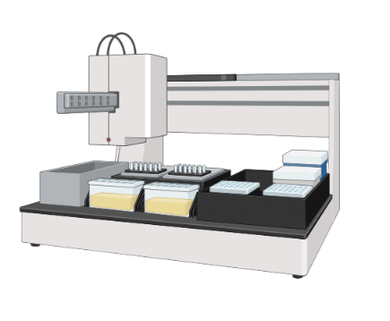
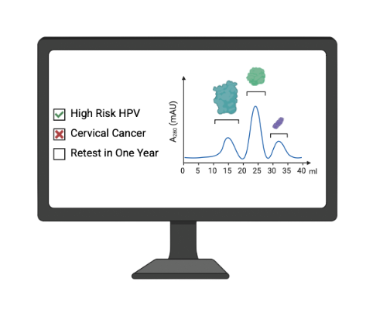
MULTIPLE METHODS OF BIOMARKER BASED TESTING
Automation Based
Lateral Flow Assay
Positive
Negative
Invalid
Notes:
BG to add the automation model (will use BioRender automation pictures to make it clear)

